Slide 1

Exploring the Reactive Extensions for JavaScript
Matthew Podwysocki @mattpodwysocki
github.com/mattpodwysocki/applicative-2015
Notes:
Hello everyone and welcome to the last talk of the day, sorry that you got stuck with me. We always want to end of a high note of telling people how they’re doing programming completely wrong, and you won’t be disappointed today.
Today, my task is to tell how we’re doing it all wrong with promises, you know, the new kid on the block that everyone’s starting to use now. And how better than to have John McCarthy of Lisp fame telling us that we’re doing programming completely wrong!
interface Disposable {
dispose() : void
}
interface Observable<T> {
subscribe(observer : Observer<T>) : Disposable
}
interface Observer<T> {
onNext(value : T) : void
onError(error : Error) : void
onCompleted() : void
}

Slide 2

OR:
HOW I LEARNED TO STOP WORRYING ABOUT ASYNCHRONOUS PROGRAMMING AND LOVE THE OBSERVABLE
Notes:
The alternative for my talk being how I learned to stop worrying about asynchronous programming and love the observable. Sorry, I don’t have the hat for this scene!

Slide 3
Or "I thought I had a problem. I thought to myself, "I know, I'll solve it with promises and events!". have Now problems. two I
Notes:
Hey, why not an alternative title as well?
Or, I thought I had a problem and I thought to myself, “I know, I’ll solve it with callbacks and events” have Now problems. two I
Concurrency jokes, they never get old!

Slide 4

Notes:
In today’s talk there will be no mention of monads, no category theory will be harmed during this presentation. And lastly, no, monads are not like burritos or any other analogy you can think of.

Slide 5

Principal SDE Open Sourcerer @mattpodwysocki github.com/mattpodwysocki
Notes:
You might be wondering who I am. Well, I’m a software engineer and self proclaimed open sourcerer. I’m fairly unoriginal in my account names, so chances are if you find me on one, you’ll find me other places.

Slide 6

Notes:
And I work for a small startup, not in the Silicon Valley, but in Redmond, Washington of all places. And I’d like to think that I’m putting the metal back in Microsoft. Yep, adding umlauts to anything makes it more metal!

Slide 7
Reactive Extensions
(Rx)
@ReactiveX
http://reactivex.io
Notes:
So, I work on a product called the Reactive Extensions, a language neutral approach to asynchronous and event based programming, which oddly enough comes up in this talk.
Click – And yes, I am Matthew Podwysocki and I’m an Rx Pusher.
I’ve been working on the team since 2010, mostly focused on JavaScript and .NET, with a little bit of Ruby, trying to make all languages kick ass. Check out our new website there with all the information forthcoming.

Slide 8
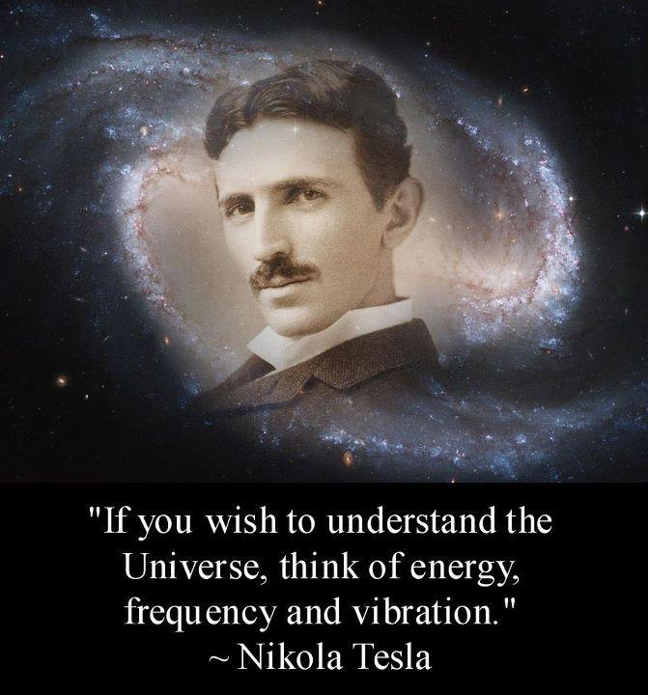
An Accidental Discovery
Cloud Programmability Team
“Oasis” within Live Labs and later the SQL Server organization
Founded by Erik Meijer and Brian Beckman
Code-named “Tesla” after Nikola Tesla (not the car)
Founded in the mid 2000s
Making sense of this new thing called “cloud”
Various projects
IL2JS – a compiler from IL to JavaScript
Extension to JavaScript with classes, modules, types
Embarrassingly distributed build system for the cloud
Reactive Extensions aka “LINQ to Events”
Nikola Tesla www.knowledgeoftoday.org

Slide 9
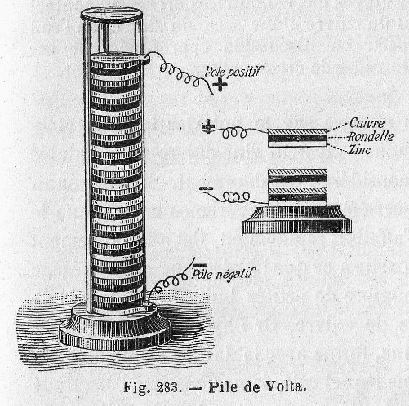
An Accidental Discovery
Project “Volta”
Tier-splitting of applications
Write as single-tier .NET application using metadata annotations
Attributes like [RunOnClient]
Cross-compilation of code to match client capabilities
Desktop CLR or Silverlight when available
IL to JavaScript when necessary
Even compiling Windows Forms controls to HTML
No promises or futures
async/await with Task<T> was unheard of (C# 5.0)
But the web is asynchronous…
www.Wikipedia.org

Slide 10

An Accidental Discovery
Project “Volta”
Dealing with asynchrony across tiers
Ultimately needs to cross-compile to AJAX
Events are not first-class objects
Can’t transport them across tiers
An electric eel…
[RunOnClient]
public event EventHandler<MouseEventArgs> MouseMoved;
// Runs in cloud
public void CloudCanvas()
{
MouseMoved += (o, e) => { /* do stuff */ };
}

Slide 11

Making Events First-Class
First class === has object representation
Methods can be transported using delegates
But properties, indexers, and events are metadata citizens
http://en.wikipedia.org/wiki/First-class_citizen
Action a = new Action(Foo); // explicit creation of delegate instance
Action b = Foo; // method group conversion
Action c = () => { … }; // creates anonymous method
void Foo() { … }
event Action Bar // metadata that refers to …
{
add { … } // add accessor
remove { … } // remove accessor
}

Slide 12
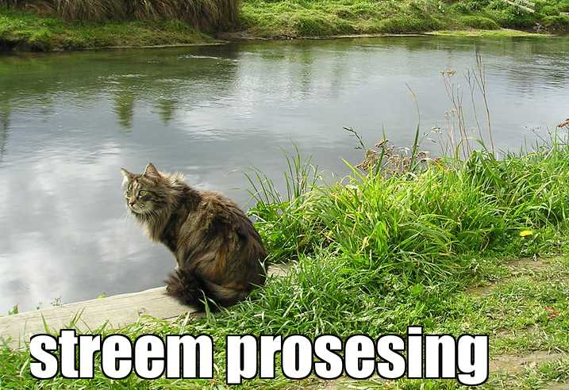
Notes:
Now, what we’re really talking about here is stream processing and what benefits you can get from it.

Slide 13

Real-Time is Everywhere…
Notes:
The world of application development is changing, we are constantly connected to any number of data sources at once. Take for example your phone, it gets texts, GPS, twitter updates, accelerometer movements, and many more things. In fact, it’s hard to find a modern app or device that doesn’t have many connections to it.
This data of course comes in many forms, whether it is stock tickers, RSS feeds, GPS feeds, servers, mouse events and even social media. All of these of course, are databases in one form or another, but in some cases the data just doesn’t exist yet. This mouse here in my hand is a database, as it has infinite amounts of mouse movements clicks and other data, so wouldn’t be it nice to be able to write queries for it? Wouldn’t it be nice to say the same for all these data sources?
How do you do advanced queries over social media in order to see what’s trending
Lots of data over a small period of time that you want to react to
Now, let’s say you want to add another data source? Add in YouTube?
Reaction time is of the essence when dealing with real-time data (don’t want to know what’s trending 5 minutes ago, but *right now*)
Want to be able to compose this with any number of other data sources, either internally or externally (such as user’s interaction with the app, e.g., tagging and commenting)
Coordinating these data sources today is very difficult, and that’s the point of the Reactive Extensions, to unify them all

Slide 14

Let’s Face It, Asynchronous Programming is Awful!
Notes:
Let’s face it, asynchronous programming is annoying to say the very least. How many abstractions do we really need? In JavaScript, we have no choice but to face up to this fact, since we’re in a single threaded environment. Our only real built in mechanisms were callbacks and events. Coordinating all of these things together eventually get you like this poor kid trying to catch the water. It isn’t happening…

Slide 15
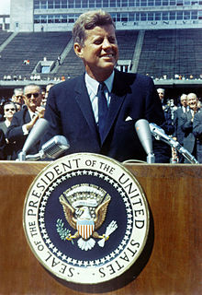
“We choose to go to solve asynchronous programming and do the other things, not because they are easy, but because they are hard”
Former US President John F. Kennedy - 1962
[citation needed]
Notes:
This problem around asynchronous and event-based programming became such a problem that a former US President, who is also known for his speech in which he said “Ich bin ein Berliner”, weighed in. He said we choose to solve asynchronous programming and do other things, not because they are easy, but because they are hard.
Click – citation needed, argh. Thank you Wikipedia!
http://en.wikipedia.org/wiki/We_choose_to_go_to_the_Moon

Slide 16

Callback Hell
function play(movieId, callback) {
var movieTicket, playError,
tryFinish = function () {
if (playError) {
callback(playError);
} else if (movieTicket && player.initialized) {
callback(null, ticket);
}
};
if (!player.initialized) {
player.init(function (error) {
playError = error;
tryFinish();
}
}
authorizeMovie( function (error, ticket) {
playError = error;
movieTicket = ticket;
tryFinish();
});
});
Notes:
As JavaScript developers, we’re very used to callbacks and programming in a continuation passing style. Now callback hell is a very real thing. If you’ve been in the JavaScript world long enough, then you’ve had to deal with trying to do sequential processing of some sort with asynchronous code. Trying to find the logic versus fighting the callback nature, it’s easy to get lost. That and I’m sure there are errors in this code.
What you end up with is what we’ll call a cow’s head, because it kind of has that shape.
Yes, there are websites such as Max Ogden’s awesome site called callback hell, which then tries to solve some of those issues, but ultimately, it’s not a programming model that scales real well.

Slide 17

Notes:
I don’t know about you, but this is my usual reaction to when I’m writing complex code with callbacks. As in the infomercials, there has to be a better way, right?

Slide 18

Events and the Enemy of the State
var isDown = false, state;
function mousedown (e) {
isDown = true;
state = { startX: e.offsetX,
startY: e.offsetY; }
}
function mousemove (e) {
if (!isDown) { return; }
var delta = { endX: e.clientX - state.startX,
endY: e.clienyY - state.startY };
// Now do something with it
}
function mouseup (e) {
isDown = false;
state = null;
}
function dispose() {
elem.removeEventListener('mousedown', mousedown, false);
elem.removeEventListener('mouseup', mouseup, false);
doc.removeEventListener('mousemove', mousemove, false);
}
elem.addEventListener('mousedown', mousedown, false);
elem.addEventListener('mouseup', mouseup, false);
doc.addEventListener('mousemove', mousemove, false);
Notes:
Let’s look at yet another problem most developers face nowadays. Let’s start with a simple example of drag and drop or rather to track Will Smith’s moves in Enemy of the State. We must have a flag as to whether the mouse is down and the state of where the mouse went down. On the mouse move, if the mouse is down, we calculate the delta between the start and now, and then do something with it. Then on mouseup, we clear the state, and set the flag.
We also have to be mindful of not only adding these event listeners, but also removing them once we’re done. That’s a major area on memory leakage in today’s apps.
Not only that, but it’s pretty hostile to adding new behaviors. For example what if I want to add effects or something else? Then I need to dig into the mousemove function, add stuff and hope and pray for the best!

Slide 19

Notes:
What a mess! Can we do better?

Slide 20


Slide 21
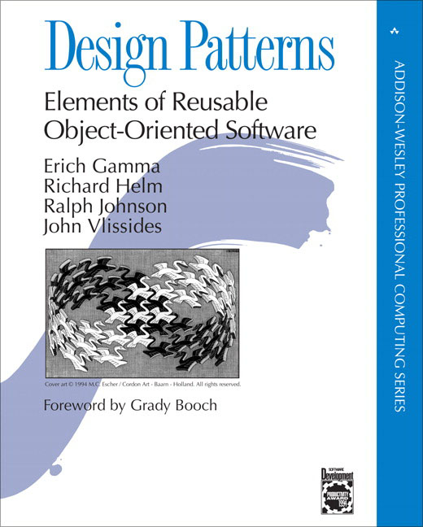

Slide 22
Iterator Pattern
> var iterator = getNumbers();
> console.log(iterator.next());
> { value: 1, done: false }
>
> console.log(iterator.next());
> { value: 2, done: false }
>
> console.log(iterator.next());
> { value: 3, done: false }
>
> console.log(iterator.next());
> { done: true }
>

Slide 23

Observer Pattern
> document.addEventListener(
"mousemove",
function next(e) {
console.log(e);
});
> { clientX: 425, clientY: 543 }
> { clientX: 450, clientY: 558 }
> { clientX: 455, clientY: 562 }
> { clientX: 460, clientY: 743 }
> { clientX: 476, clientY: 760 }
> { clientX: 476, clientY: 760 }
> { clientX: 476, clientY: 760 }
> { clientX: 476, clientY: 760 }

Slide 24

Fundamental Abstractions
Adapting the observer pattern
Ensuring duality with the enumerator pattern
More compositional approach
“Gang of four” book
Addison-Wesley
interface Observable<T> {
subscribe(observer : Observer<T>) : Disposable
}
interface Observer<T> {
onNext(value : T) : void
onError(error : Error) : void
onCompleted() : void
}

Slide 25
“What’s the difference between an Array…
[{x: 23, y: 44}, {x:27, y:55}, {x:27, y:55}]

Slide 26
… and an Event?
{x: 23, y: 44}...{x:27, y:55}.... {x:27, y:55}......

Slide 27
Events and Arrays are both collections.

Slide 28
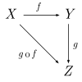
The Beauty of Duality
Category theory
www.Wikipedia.org
Category theory to the rescue
Observable/observer (push) is dual to enumerable/enumerator (pull)
Cross-influence of both domains
interface Observable<T> {
subscribe(observer : Observer<T>) : Disposable
}
interface Observer<T> {
onNext(value : T) : void
onError(error : Error) : void
onCompleted() : void
}
interface Enumerable<T> {
[Symbol.iterator]() : Enumerator<T>
}
interface Enumerator<T> {
next() : EnumeratorValue<T> // throws
}
interface EnumeratorValue<T> {
done : boolean
value : T
}

Slide 29
The majority of your asynchronous code can be written with just a few flexible functions.

Slide 30
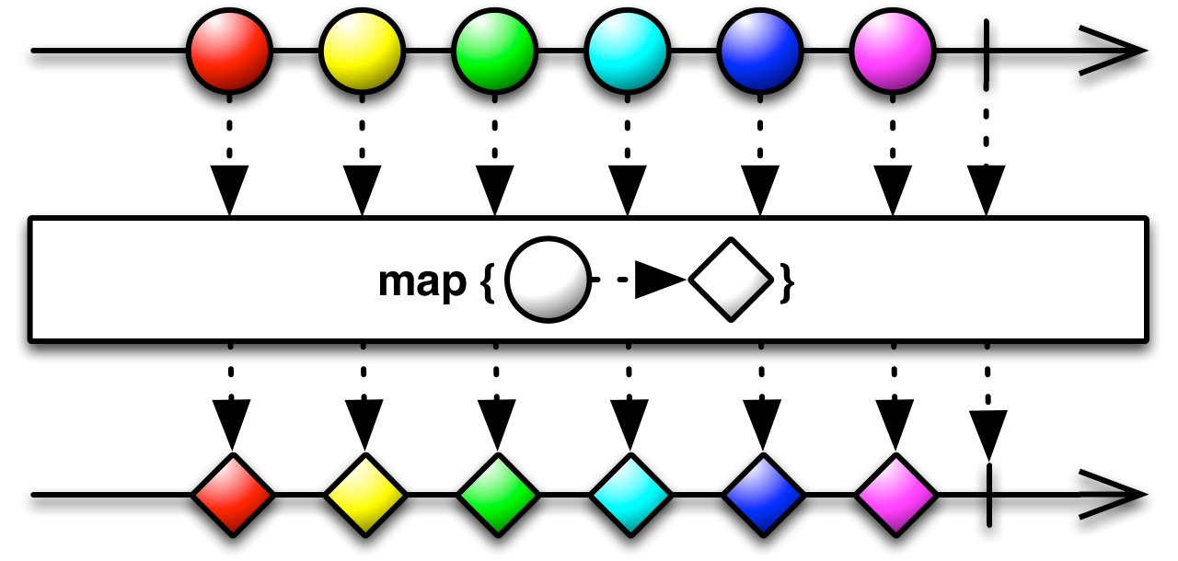
map()
Transform the items emitted by an Collection by applying a function to each of them

Slide 31
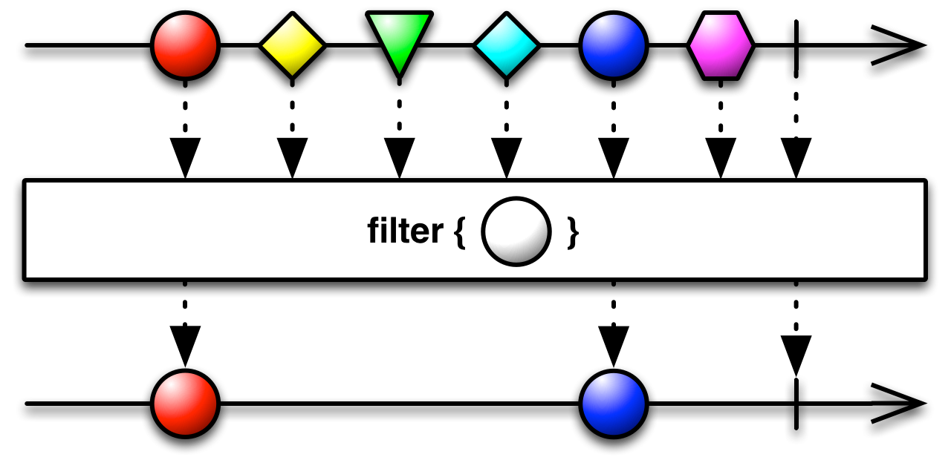
filter()
Filter items emitted by a Collection

Slide 32
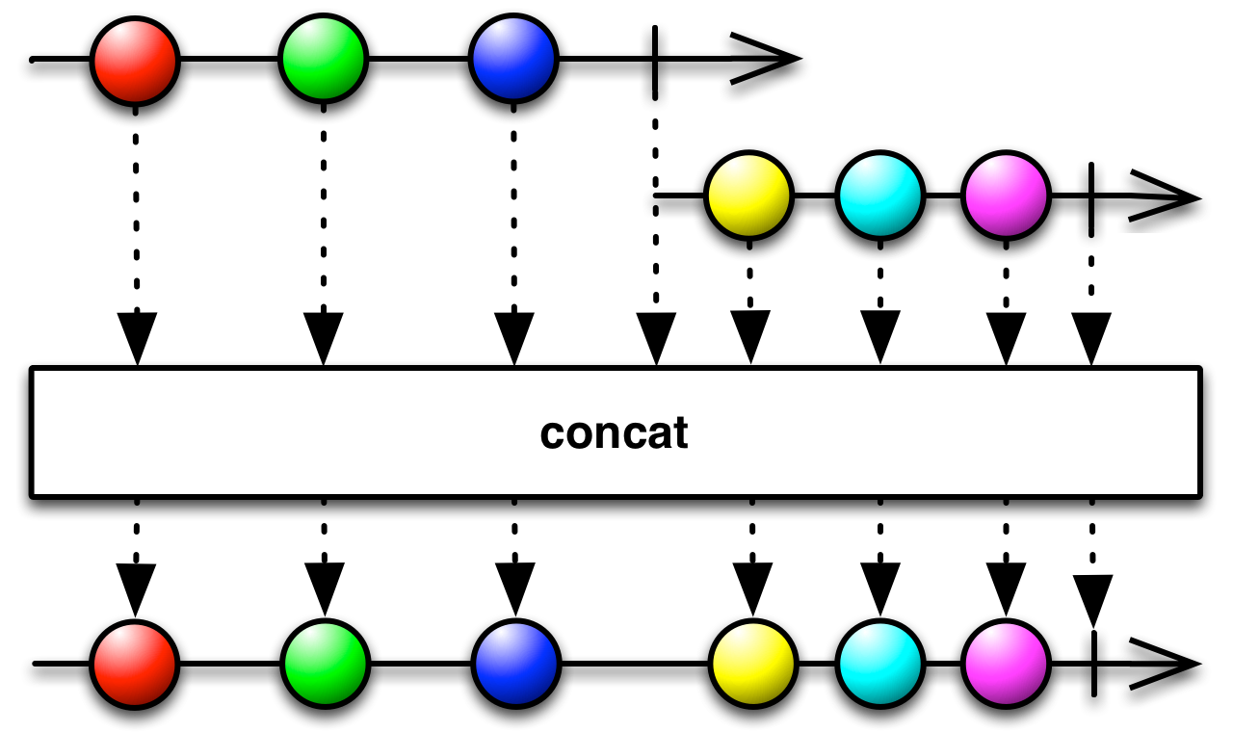
concatAll()
Concatenate two or more Collections sequentially

Slide 33
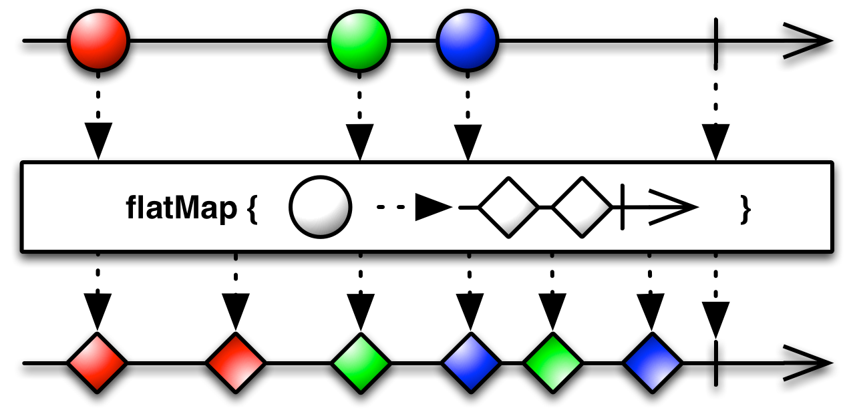
flatMap()
Transform the items emitted by a Collection into Collections, then flatten this into a single Collection

Slide 34


Top-rated Movies Collection
var getTopRatedFilms = function (user) {
return user.videoLists
.map(function (videoList) {
return videoList.videos
.filter(function (v) { return v.rating === 5; });
}).concatAll();
}
getTopRatedFilms(me)
.forEach(displayMovie);
Notes:
Now let’s see some more code…..

Slide 35
Top-rated Movies Collection
var getTopRatedFilms = function (user) {
return user.videoLists
.flatMap(function (videoList) {
return videoList.videos
.filter(function (v) { return v.rating === 5; });
});
}
getTopRatedFilms(me)
.forEach(displayMovie);
Notes:
Now let’s see some more code…..

Slide 36
What if I told you…
…that you could create a drag event…
…with the almost the same code?
Notes:
Now, what if I told you, the Netflix API calls we just made, we could do pretty much the same thing with a mouse drag, all with almost the same code? Would you believe me?

Slide 37
Mouse Drags Collection
var getElementDrags = function (elmt) {
return dom.mousedown(elmt)
.map(function (md) {
return dom.mousemove(document)
.filter .takeUntil(dom.mouseup(elmt));
}).concatAll();
};
getElementDrags(image)
.forEach(moveImage)
Notes:
And it turns out we can. If we’re given an element, then imagine we had an extension method that exposed MouseDowns as an observable sequence, then we can use Select to map mouse downs to the mouse moves extension method, stopping when we hit mouse ups. Then we merge it all back together into a nice little sequence. Of course for you C# folks here, we could have used SelectMany and not needed the Merge, but that’s all SelectMany really is, Select and Merge.

Slide 38
Mouse Drags Collection
var getElementDrags = function (elmt) {
return dom.mousedown(elmt)
.flatMap(function (md) {
return dom.mousemove(document)
.filter .takeUntil(dom.mouseup(elmt));
});
};
getElementDrags(image)
.forEach(moveImage)
Notes:
And it turns out we can. If we’re given an element, then imagine we had an extension method that exposed MouseDowns as an observable sequence, then we can use Select to map mouse downs to the mouse moves extension method, stopping when we hit mouse ups. Then we merge it all back together into a nice little sequence. Of course for you C# folks here, we could have used SelectMany and not needed the Merge, but that’s all SelectMany really is, Select and Merge.

Slide 39

Notes:
It’s kind of that zen-like moment when you realize, yes, everything is a stream. And yes I had to throw in a dog picture to offset the number of cat pictures I’ve already had.

Slide 40
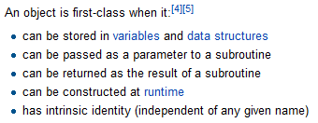

First-Class Asynchronous Values
Notes:
The great news is with Promises, we now have a concept of a first class asynchronous value. What does that mean? Well, you can take one as an argument, you can return it from a function. This makes it great for testing purposes and so forth that you have this first class value, unlike with callbacks.

Slide 41
The General Theory of Reactivity
Array
Observable
res =
stocks
.filter(q => q.symbol == 'FB')
.map(q => q.quote)
res.forEach(x =>
...
res =
stocks
.filter(q => q.symbol == 'FB')
.map(q => q.quote)
res.forEach(x =>
...
Multiple values (*)
Object
Promise
Single value (1)
var y = f(x);
var z = g(y);
fAsync(x).then(...);
gAsync(y).then(...);
Synchronous
Asynchronous
Notes:
When we talk about the programming landscape, we’re talking about synchronous and asynchronous, single value and multi-value first class objects.
Single synchronous values are simply just objects, whether functions, etc, whereas with multi-value, we have Arrays, as well as Sets, Maps, and even Generators.
An asynchronous, single value item is a Promise and something is asynchronous and multi-valued, it’s an Observable.

Slide 42
What is Reactive Programming Anyhow?
Merriam-Webster defines reactive as “readily responsive to a stimulus”, i.e. its components are “active” and always ready to receive events.
Wanna really know what Reactive Programming Is?
Real Time Programming: Special Purpose or General Purpose Languages Gerard Berry
http://bit.ly/reactive-paper
Notes:
So, there has been a big buzz around Reactive Programming Lately, and I think partially due to the popularity of the Reactive Extensions. That and the Coursera Course of Reactive Programming came out. How many people did that course? How many actually finished it? Well, you’re all Reactive Programmers now!
The Reactive Manifesto was a document that came out to try and define what exactly reactive programming is. Much like a lot of things like Functional Programming where it’s kind of fuzzy as to what it truly means to be a functional language. Here at least we break it down to its essentials, as in “readily responsive to a stimulus.
It’s broken into four parts,
1: Reacts to Events, so, event driven
2: Reacts to loads, meaning it can somehow deal with load as it comes through
3: React to failure, so, some sort of compensation logic
4: Finally react to users. Give them something timely without locking up the application
That’s it. That’s all you need to know.

Slide 43
Functional Reactive Programming (FRP) is…
A concept consisting of
Continuous Time
Behaviors: Values over time
Events: Discrete phenomena with a value and a time
Compositional behavior for behavior and events
What it is not
High order functions on events like map, filter, reduce
Most so-called FRP libraries out there…
http://stackoverflow.com/questions/1028250/what-is-functional-reactive-programming
Notes:
Function Reactive Programming you may have heard a lot about recently. So, what exactly is it? First off, it has a notion of continuous time.
First part is a notion of behaviors, which is to say values over time. A clock is a perfect example of that, as it has a notion of a current time, and it is always moving.
The second notion is a discrete event, think something like a mouse click. It doesn’t really have a value per se, but when it happens, it yields a value and a timestamp.
What is it not?
First off, it’s not just high order operators on events like map, filter, reduce, and I’d say a good majority of the libraries that say they are FRP, are really not.

Slide 44
You already know how to do this….
INTERACTIVE
REACTIVE
var source = getStockData();
source
.filter(function (quote) {
return quote.price > 30;
})
.map(function (quote) {
return quote.price;
})
.forEach(function (price) {
console.log(‘Higher than $30: $' + price);
});
var source = getStockData();
source
.filter(function (quote) {
return quote.price > 30;
})
.map(function (quote) {
return quote.price;
})
.forEach(function (price) {
console.log(‘Higher than $30: $' + price);
});
Notes:
But best of all with streams and Rx is that you already know how to do this. You already know how to use the Array#extras in JavaScript (or at least I hope you all do), well, then you already know RxJS. There is no difference in the code you just wrote other than the getStockData in the interactive version was an array, and in the reactive version, it was an Observable.

Slide 45
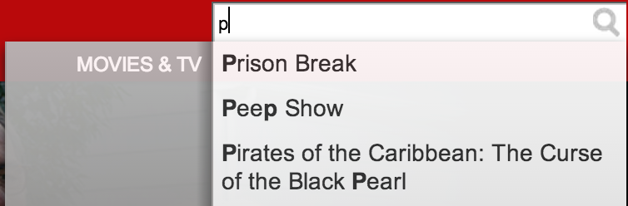
Netflix Search

Slide 46

Autocomplete with Observables
DOM events as a sequence of strings
var data = dom.keyup(input)
.map(function() { return input.value; })
.debounce(500)
.distinctUntilChanged()
.flatMapLatest( function(term) { return search(term); } );
data.subscribe(function(data) {
// Bind data to the UI
});
Reducing data traffic / volume
Latest response as movies
Web service call returns single value sequence
Binding results to the UI
Notes:
Now let’s take a look at a more interesting example. What if we could put together observables ? How would that work?
Well, what we can do is get the keyup first class event, then map it to get the current value of the text box. First and foremost, we don’t want to overload the server with too many requests at once, because bandwidth is money. So, we can throttle it by half a second to ensure we stop typing that long, and then we want to make sure we’re only sending over distinct data.
Next we need to take the throttled input and query the service which may return a Promise. Proper handling of asynchronous behavior is important and order matters. If I type react then type reactive, yet reactive comes back first, we don’t want to have the result from our first request to clobber the results from our last. That’s a typical mistake I see in a lot of applications. To fix that, we call flatMapLatest in which your map function returns an observable of observables and then flatMapLatest cancels all previous requests and only returns the latest value. What’s great about how we implemented this is that our search function could be either an observable and even, yes, a Promise.

Slide 47
What exactly is Rx?
Language neutral model with 3 concepts:
Observer/Observable
Query operations (map/filter/reduce)
How/Where/When
Schedulers: a set of types to parameterize concurrency
Notes:
What is Rx anyways?
We can boil it down to three main concepts
1 The observable and observer objects which we’ve already seen.
2 Query operations such as map, filter, reduce, etc
3 We need to control how/when and where an operation is fired, therefore we have a notion of schedulers.
And probably the most overlooked part is that it’s a concept that can easily span languages as we have implementations in .NET, C++, Java, JavaScript, Python, ObjC, and the beginnings of implementations in Ruby and Swift

Slide 48
Rx Grammar Police
* ( | ) ?
onNext
Zero or more values
E.g. events are ∞ sequences
onError
Calls can fail
onCompleted
Resource management
Sequencing
ü
0
1
2
ü
0
1
2
ü
Must be a sequence
No concurrent callbacks
One time termination
0
1
û
0
2
1
Notes:
As we noted earlier, the observer has three parts, the onNext, onErrorand onCompleted
The onNext will be called zero to infinite times producing values
The onError handler will be at most called once should an operation fail such as a web request
The onCompeted handler will also be called at most once at the end of an operation if there is one.
Why do we need a grammar to formalize this?
Reason for grammar:
in interactive programming, know exactly when you’re going to get the next element
since elements are spaced out over time, we make the grammar explicit
this is the exact same grammar as a pull-based collection (if there’s an error, can’t get more elements, can’t get to the end twice

Slide 49
What exactly is Rx?
Language neutral model with 3 concepts:
Observer/Observable
Query operations (map/filter/reduce)
How/Where/When
Schedulers: a set of types to parameterize concurrency
Notes:
The second part and probably the most used part of Rx is the query operations. These include the most common functional ones you can think of including map/filter/reduce, etc, but with an added notion of time.

Slide 50

Observables - Querying UI Events
var mousedrag = mousedown.flatMap(function (md) {
// calculate offsets when mouse down
var startX = md.offsetX,
startY = md.offsetY;
});
1
For each mouse down
Notes:
We’re going to take the example from before with the drag and drop and use Observables to make that happen.
We can start off by taking the mouse down events and calling flatMap which is essentially mapping each value to a set of values and then flattening it, so you don’t end up with a sequence of sequences. Then we can start by getting the starting position for later usage.

Slide 51
Observables - Querying UI Events
var mousedrag = mousedown.flatMap(function (md) {
// calculate offsets when mouse down
var startX = md.offsetX,
startY = md.offsetY;
// calculate diffs until mouse up
return mousemove.map(function (mm) {
return {
left: mm.clientX - startX,
top: mm.clientY - startY
};
})
});
1
For each mouse down
2
Take mouse moves
Notes:
Now what we’re going to do is then take the mouse movements and map them so that we calculate the offsets between the starting location when the mouse button went down and when the mouse began to move, so that we could reposition our image to the new location.
Now, how do we stop listening? You stop when the mouse goes up

Slide 52
Observables - Querying UI Events
var mousedrag = mousedown.flatMap(function (md) {
// calculate offsets when mouse down
var startX = md.offsetX,
startY = md.offsetY;
// calculate diffs until mouse up
return mousemove.map(function (mm) {
return {
left: mm.clientX - startX,
top: mm.clientY - startY
};
}).takeUntil(mouseup);
});
1
For each mouse down
2
Take mouse moves
3
until mouse up
Notes:
We can get that exact behavior that we’re looking for by using the takeUntil operator which stops the sequence when another observable sequence fires.
Now we can easily say that mouse drag is really just mouse down and mouse move until mouse up, which is exactly what we’re showing here. Not only that, but when we subscribe, we add event handlers to the events, and when we dispose, we remove all event handlers automatically.

Slide 53
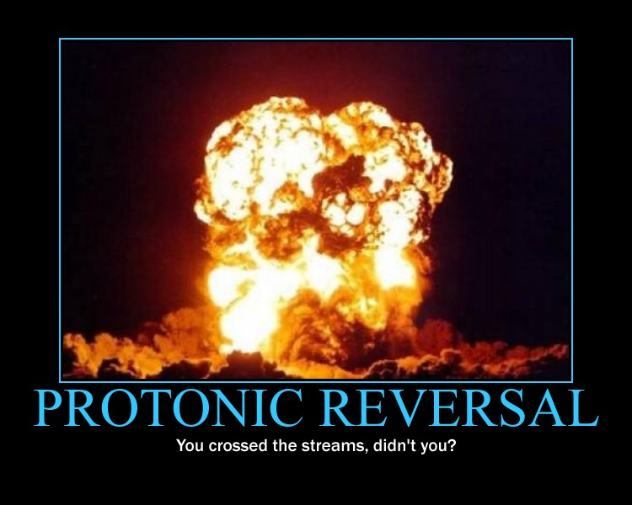

Slide 54
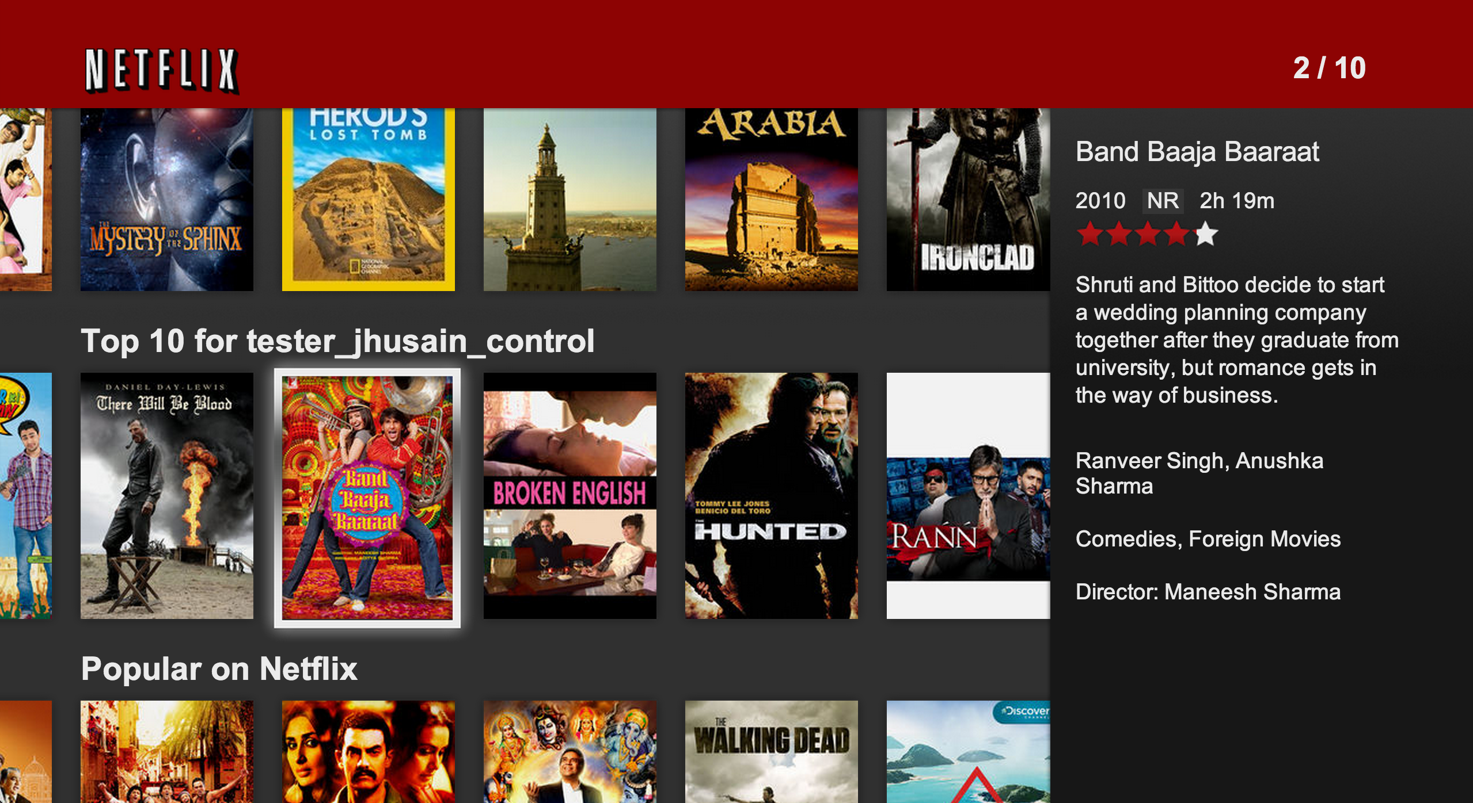
Your Netflix Video Lists Netflix Row Update Polling
Notes:
Here’s another hard problem that we face pretty much on a daily basis. How do we only load what’s in view, so when you scroll, you’re only loading what you need. Then, when it’s out of site, then, well, we can clean up the DOM and keep our memory footprint low.

Slide 55
Client: Polling for Row Updates
function getRowUpdates(row) {
var scrolls = Rx.Observable.fromEvent(document, "scroll");
var rowVisibilities =
scrolls.throttle(50)
.map(function (scrollEvent) { return row.isVisible(scrollEvent.offset); })
.distinctUntilChanged()
.publish().refCount();
var rowShows = rowVisibilities.filter(function (v) { return v; });
var rowHides = rowVisibilities.filter(function (v) { return !v) });
return rowShows
.flatMap(Rx.Observable.interval(10))
.flatMap(function () { return row.getRowData().takeUntil(rowHides); })
.toArray();
};
Notes:
So, how do we poll for updates on the client based upon scrolling?
We start off by getting the scrolls, then we get the row visibilities, throttling it just a little bit so that we’re not firing it too many times, then we’re going to determine whether the row is visible, make sure it’s distinct (meaning true/false), and then share it out to the world.
We can then create rowShows and rowHides streams based upon whether it is visible or not.
Now, it’s just simple composition, take the row shows, chain it to an interval of 10 ms, then chain it to getting the row data, until the row is hidden. Finally, returning it all as an Observable of an array.

Slide 56
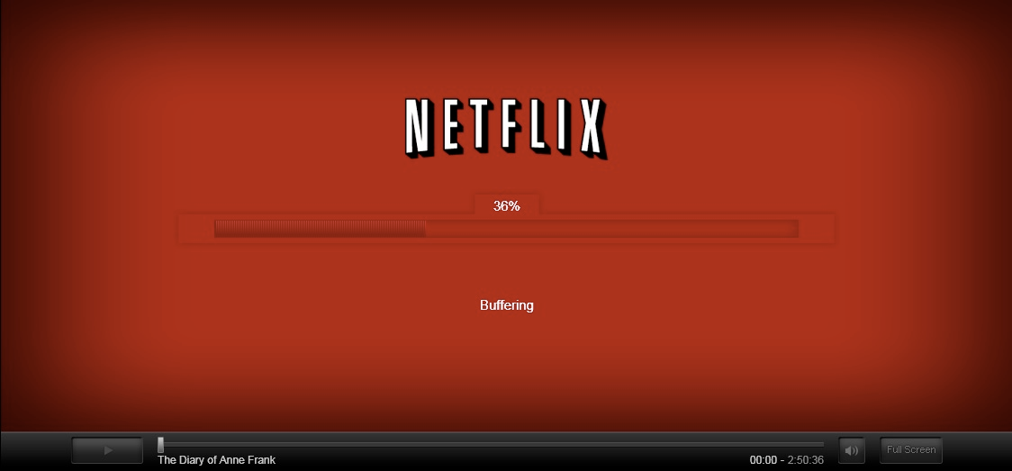
Netflix Player

Slide 57
Player Callback Hell
function play(movieId, cancelButton, callback) {
var movieTicket,
playError,
tryFinish = function() {
if (playError) {
callback(null, playError);
}
else if (movieTicket && player.initialized) {
callback(null, ticket);
}
};
cancelButton.addEventListener(“click”, function() { playError = “cancel”; });
if (!player.initialized) {
player.init(function(error) {
playError = error;
tryFinish();
}
}
authorizeMovie(movieId, function(error, ticket) {
playError = error;
movieTicket = ticket;
tryFinish();
});
});

Slide 58
Player With Observables
var authorizations =
player
.init()
.flatMap(function () {
return playAttempts
.flatMap(function (movieId) {
return player.authorize(movieId)
.retry(3)
.takeUntil(cancels));
})
});
authorizations.forEach(
function (license) { player.play(license); },
function (error) { showDialog("Sorry, can’t play right now."); });

Slide 59
What is Rx?
Language neutral model with 3 concepts:
Observer/Observable
Query operations (map/filter/reduce)
How/Where/When
Schedulers: a set of types to parameterize concurrency
Notes:
The third piece of the reactive extensions is this notion of schedulers which control how, when and where an operation happens. This here is really the heart or rather the brain of the reactive extensions, and what makes it unique from any other functional reactive programming library.
At any point in the query, we should be able to change the concurrency model or simply where the code executes. As we saw previously, Donna used ObserveOnDispatcher to ensure that the observer notified on the dispatcher thread. But note that the timer and all other observables could happen on another thread, so you don’t have to lock the UI for the entire query.

Slide 60
The Role of Schedulers
Many implementations
Cancellation
Key questions:
How to run timers?
Where to produce events?
Need to synchronize with the UI?
Schedulers are the answer:
Schedulers introduce concurrency
Operators are parameterized by schedulers
Provides test benefits as well
d = scheduler.schedule(
function () {
// Asynchronously
// running work
},
1000);
Optional time
Notes:
We have some key questions to ask whenever you are doing an asynchronous computation.
How do run a timer?
Which thread or which machine will receive an event?
Do we need to be on a special thread for updating the system?
Schedulers are a single answer to all of the questions
They introduce concurrency
Many operators provide overloads with schedulers which allow you to change the concurrency model
This also provides us with a huge testing benefit which we’ll see in the next slide.

Slide 61
Testing concurrent code: made easy!
var scheduler = new TestScheduler();
var input = scheduler.createHotObservable( onNext(300, 'Applicative'), onNext(400, '2015'), onCompleted(500));
var results = scheduler.startWithCreate(function () { return input.pluck('length'); });
results.messages.assertEqual( onNext(300, 11), onNext(400, 4), onCompleted(500));
Notes:
Writing asynchronous code in any language is hard enough, but testing it can be a nightmare. You could be caught in thread sleeps or timers to test whether asynchronous behavior happened.
The Reactive Extensions solves this through a virtual time scheduler. There are a number of them built in including an HistoricalScheduler for replaying historical data, but also there’s a (click) TestScheduler whose sole purpose is to provide a mechanism for deterministic testing without having to create any artificial delays.
(click)
We can also simulate observables which fire at predefined virtual times with values. This happens all in real time, no waiting required. I could in fact schedule something for the next CodeMash next year and deterministically check that my code does the right thing. Here, we’re creating an observable with two elements, strange and loop to fire at 300 milliseconds and loop to fire at 400, and a completion message at 500 ticks or virtual time.
(click)
We can get the results from our query of getting the length of each string by using the scheduler which tracks all the values and when they were produced with a virtual timestamp.
(click)
Finally, we can verify the results that at 300 milliseconds, we get a string with length of 7 and at 400 milliseconds a string of length 4 and a completion message at 500 milliseconds.
You could turn an Enumerable into an Observable such as test data from a file, and you don’t have to make your code convoluted just to make it testable.
This style we show here is exactly how we wrote our unit tests for all of our operators.

Slide 62
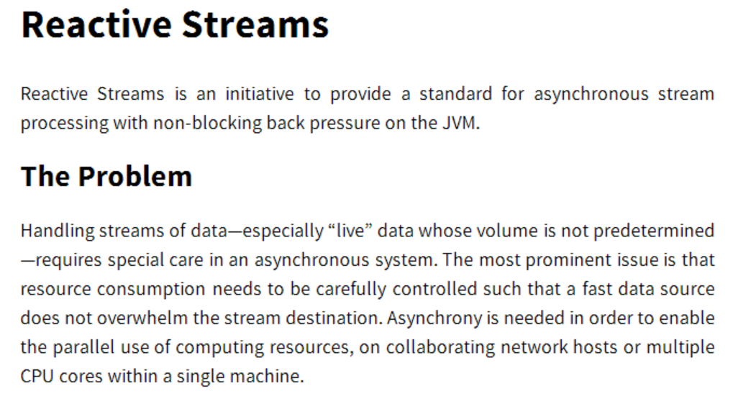
http://www.reactive-streams.org/
Notes:
Could systems such as Observables handle backpressure? Good question. The Reactive Streams effort is an effort to bring a common backpressure mechanism to streams. And guess what, we’re also involved.

Slide 63
Observables and Backpressure
Yes, Observables can have backpressure
Can be lossy (pausable, sample, throttle)
Can be lossless (buffer, pausableBuffered, controlled)
var pausable = chattyObservable.pausableBuffered();
pausable.pause();
pausable.resume();
var subscription = chattyObservable.subscribe(print);
subscription.request(10);
Notes:
The term backpressure means a lot of things, you can either apply lossy or lossless ways of handling when the producer becomes too chatty. Rx Observables support this through operators, and come version 2.4, we will be implementing implementing reactive streams in JavaScript with RxJS.

Slide 64

Notes:
That’s great that we have generators and yield, but to me, it’s rather ugly, isn’t it? Could we instead have an async/await style of programming to make it explicit for asynchronous programming?

Slide 65
Async/Await
Coming to a JavaScript Engine Near You!
Adds async and await keywords for Promises
Accepted into Stage 1 of ECMAScript 7 in January 2014
async function chainAnimationsAsync(elem, animations) {
var ret = null;
try {
for (var anim of animations) {
ret = await anim(elem);
}
} catch (e) { /* ignore and keep going */ }
return ret;
}
https://github.com/lukehoban/ecmascript-asyncawait
Notes:
And the answer is yes. Luke Hoban proposed async/await for JavaScript and was accepted into Stage 1 for ES7. This will currently work over promises or promise like contracts. Suddenly, our contract looks a bit nicer as it’s explicit that it’s an async function.

Slide 66
Async/Await with Observables and Generators…
RxJS and Generators
Adds async /await capabilities to single value Observables
Available in any runtime that has Generators
Rx.spawn(function* () {
var result = yield get('http://applicative.acm.org/')
.retry(3)
.catch(cachedVersion);
console.log(result);
}());
Notes:
And the answer is yes. Luke Hoban proposed async/await for JavaScript and was accepted into Stage 1 for ES7. This will currently work over promises or promise like contracts. Suddenly, our contract looks a bit nicer as it’s explicit that it’s an async function.

Slide 67
Async Generators
ES7 and Beyond!
First class events in the JavaScript runtime
Proposed in June 2014 at TC39
async function* getDrags(element) {
for (let mouseDown on element.mouseDowns) {
for (let mouseMove on
document.mouseMoves.takeUntil(document.mouseUps)) {
yield mouseMove;
}
}
}
http://esdiscuss.org/notes/2014-06/async%20generators.pdf
Notes:
Looking ahead, what else can we do? Where can we grow? There is an effort underway by Jafar Husain from Netflix on TC39, the ECMAScript standardization committee, for async generators, the idea that we can treat async operations or events as first class iterables. How cool would that be?

Slide 68
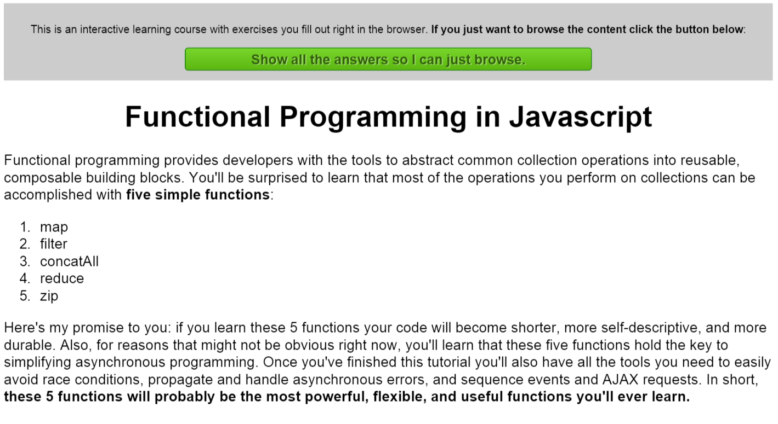
http://jhusain.github.io/learnrx/

Slide 69
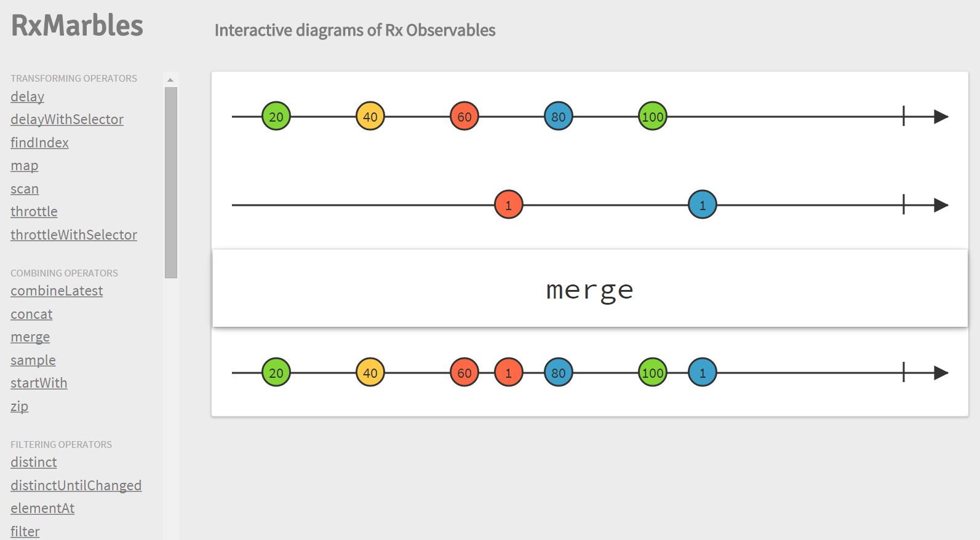
http://www.rxmarbles.com/
Notes:
If you want to learn more about how our operators work, check out Rx Marbles where you have interactive diagrams to help you learn more about our operators and how they operate.

Slide 70
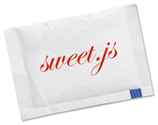
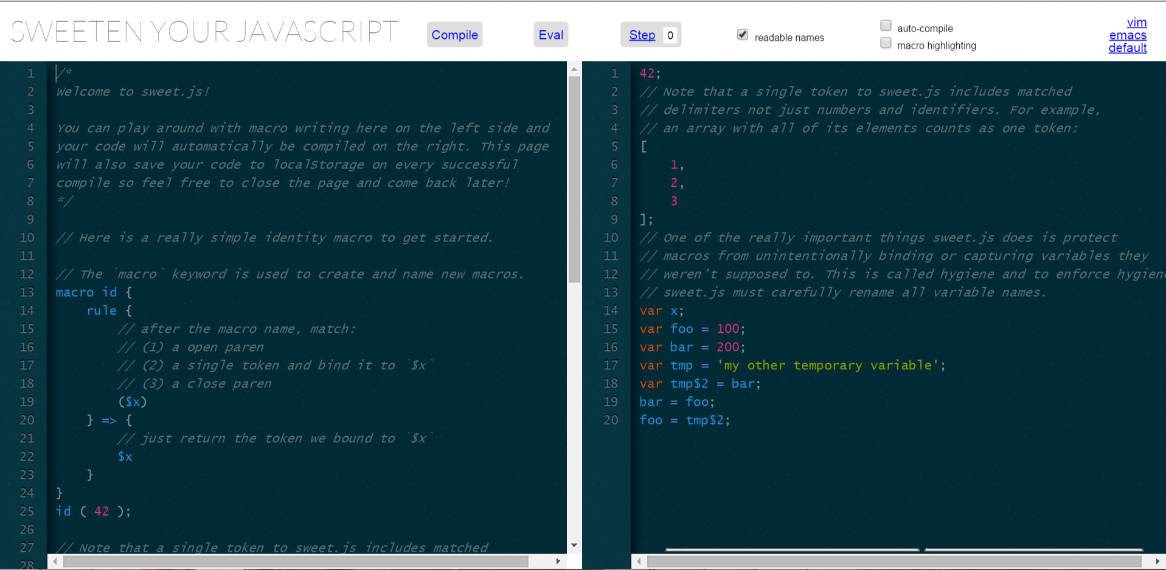
RxJS In Action

Slide 71
RxJS In Action
var documentReadyObs = $(window).readyAsObservable().take(1).publishLast(),
windowResizeObs = $(window).resizeAsObservable().startWith(true),
initEditorObs = documentReadyObs
.map(_.partial($, "#editor", undefined))
.map(_.partial(initEditor, getEditorOptions))
.map(initEditorKeyMap),
initOutputObs = documentReadyObs
.map(_.partial($, "#output", undefined))
.map(_.partial(initEditor, getOutputOptions)),
// Initialize both CodeMirror instances on document
// ready, then select them into a list together.
mirrors = initEditorObs.zip(initOutputObs, concat.bind([])).publish(),
https://github.com/mozilla/sweet.js/blob/master/browser/scripts/editor.js

Slide 72






What About My Libraries?

Slide 73
Reactive Extensions
(Rx)
@ReactiveX
http://reactivex.io
Notes:
So, I work on a product called the Reactive Extensions, a language neutral approach to asynchronous and event based programming, which oddly enough comes up in this talk.
Click – And yes, I am Matthew Podwysocki and I’m an Rx Pusher.
I’ve been working on the team since 2010, mostly focused on JavaScript and .NET, with a little bit of Ruby, trying to make all languages kick ass. Check out our new website there with all the information forthcoming.

Slide 74


